Slide 1
MODULE SPORT

Slide 2
Sport Courses
Sport Events
Complex
Sport Program
Jobs

Slide 3
USE-CASE: GENERAL
Creating & Registering Complex
Sport Programs
Subscription Pockets
Positions for Employees
Sport Groups For Trainee & Trainers

Slide 4
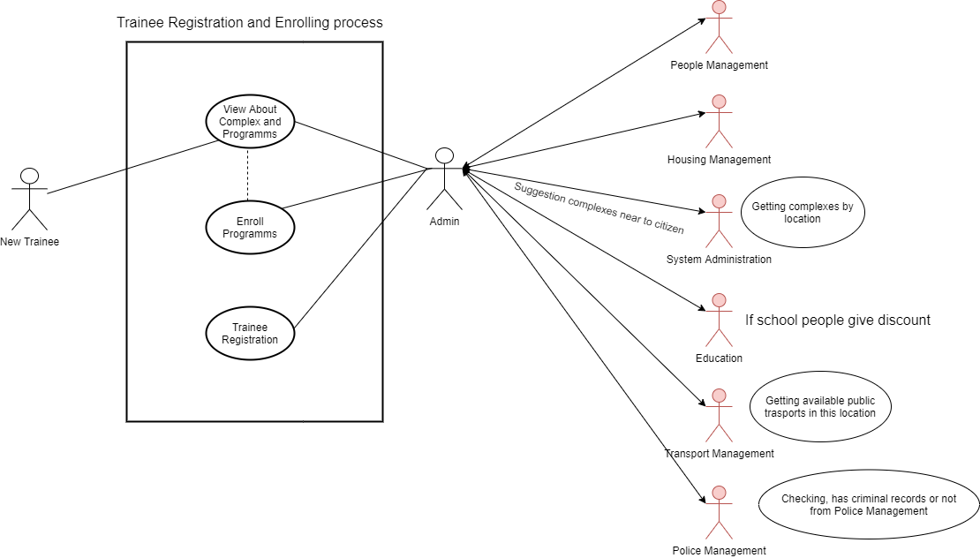

Slide 5
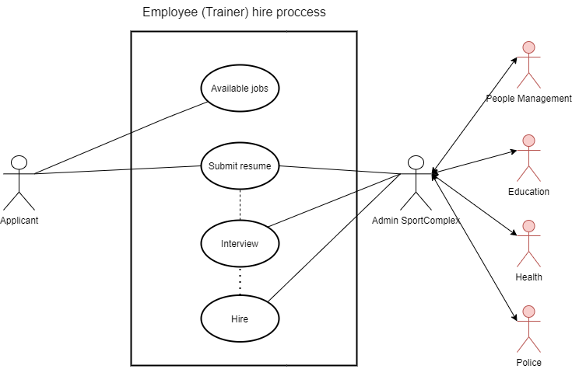

Slide 6
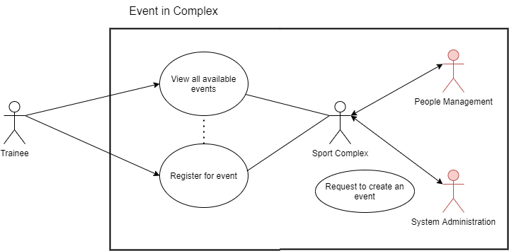

Slide 7
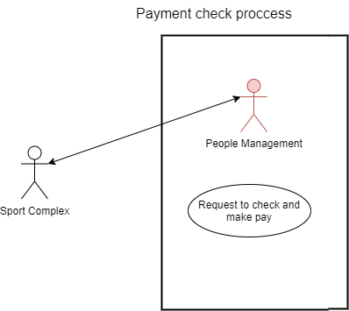

Slide 8
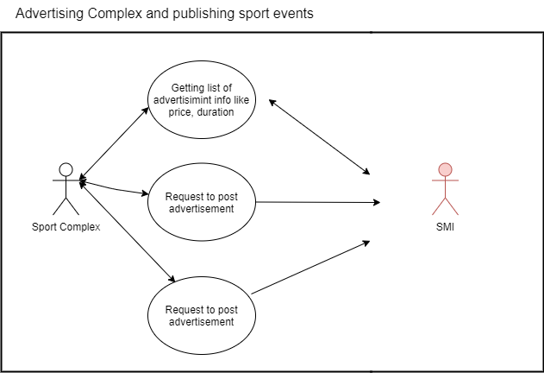

Slide 9
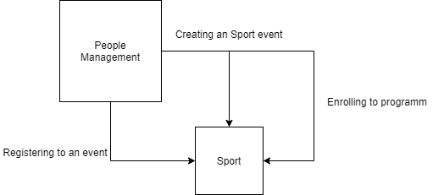

Slide 10
